Slide 1

Solve the following equations:
2(x + 1) + 4(x – 3) = 26
3x - $\frac{1}{4}$ = $\frac{4}{5}$
10 - $\frac{a+3}{4}$ = 6
$\frac{a+5}{4}$ = $\frac{a+3}{3}$

Slide 2
Using equations to solve problems

Slide 3
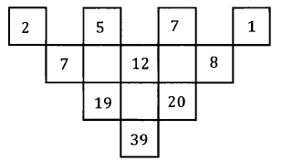

Slide 4
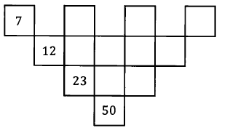
5
6
10
11
16
27

Slide 5
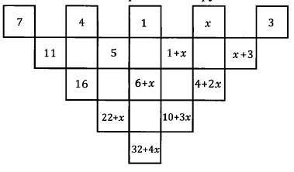
55
32 + 4x = 55

Slide 6
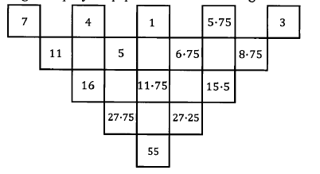

Slide 7
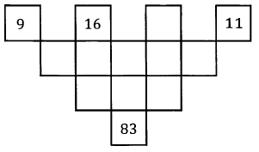

Slide 8
3
7
34

